Slide 1
Legal Secure data Transfer system
LawLock

Slide 2
agenda
Introduction
Solution
System Architecture
Visual aids & Process Flow
Compliance & Standards
Benefits foe law Enforcement
Implementation Plan
Final tips & takeaways

Slide 3

Introduction

Slide 4
INTRODUCTION
4
In today’s digital era, law enforcement agencies are responsible for managing and exchanging vast amounts of highly sensitive information, from criminal records to evidence files and intelligence reports.
The Legal Secure Data Transfer System (LSDTS) is a next-generation platform designed to ensure secure, traceable, and authorized data exchange between departments. By integrating advanced cryptographic protocols with blockchain technology, the system guarantees data integrity, transparency, and accountability at every step of the transfer process.
LSDTS empowers law enforcement to collaborate with confidence, eliminate data breaches, and maintain public trust in an increasingly digital world.

Slide 5

Our Solution
A Secure, Scalable Data Transfer Ecosystem for Law Enforcement

Slide 6
Solution
A blockchain-based data transfer platform created for law enforcement agencies. It ensures that all shared data is recorded, traceable, and protected from tampering.
The system uses BlockDAG architecture, which allows multiple transactions to run at once. This makes data transfer faster, more reliable, and scalable for large law enforcement networks.
End-to-end encryption with AES protects every file before it is sent. Only authorized users with valid cryptographic keys can decrypt and view the data.
The system follows ISO and NIST cybersecurity frameworks to meet global standards for information security and data integrity.

Slide 7
visual aids
Presenting Process Flow

Slide 8
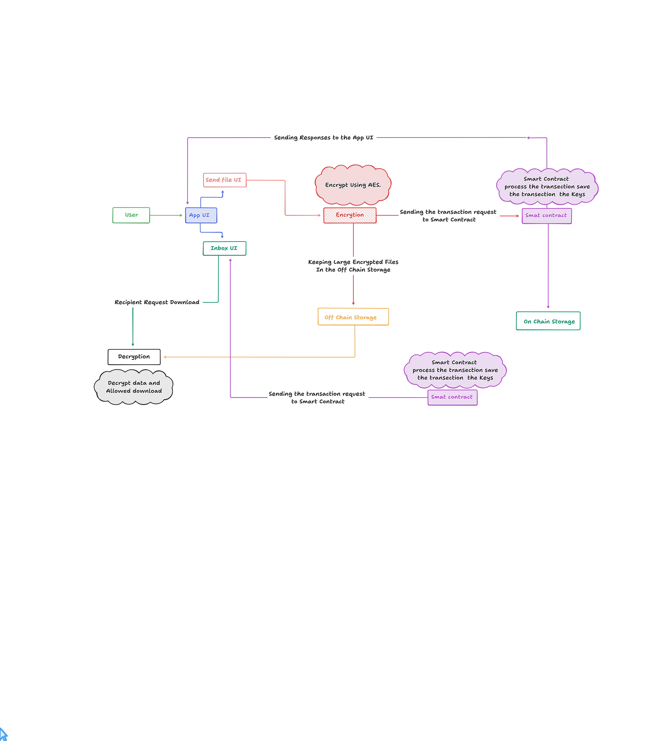

Slide 9

Process Flow
User uploads data via secure App UI.
Data is encrypted using AES.
Smart contract verifies and stores encryption keys on-chain.
Encrypted files are stored off-chain securely.
Recipients request access through smart contract verification.
Upon approval, data is decrypted and made available for download.

Slide 10
System Architecture Overview
The system employs a dual storage model:
On-Chain Storage: Holds transaction metadata and cryptographic keys.
Off-Chain Storage: Holds encrypted large files for efficient access.
Smart contracts handle validation, encryption, and data access control.

Slide 11

Compliance and Standards
ISO/IEC 27001 – Information Security Management
NIST Cybersecurity Framework – Data Integrity & Access Control
GDPR Alignment – Ensures legal data handling
Nigerian Cybercrime Act Compliance

Slide 12

Benefits for Law Enforcement
Secure and traceable communication between departments.
Eliminates unauthorized access to case data.
Reduces paper-based documentation.
Enhances trust, transparency, and accountability.

Slide 13
Final tips & takeaways
Prioritize security at every layer • Use robust encryption and authentication mechanisms
Ensure system scalability • Leverage BlockDAG for high-speed, parallel transactions • Design for future integration with larger networks
Maintain data integrity • Record every transfer on-chain for full transparency
Follow global compliance standards
Enhance user trust and adoption
Iterate, test, and evolve

Slide 14
Team Logix member
Name | Role
Aliyu Lawan | Back-End Developer
Mustapha Abdulsalam | Front End
Muhammad Auwal | Project Manager/ Team Leader
Hussain Nurudeen Imam | UI Designer

Slide 15
Thank you
Team Logix
Design it. Code it. Launch it to the world.

